Slide 1
{‘DSIF3’ : ‘Group5’: [‘Project_1’]}

Slide 2
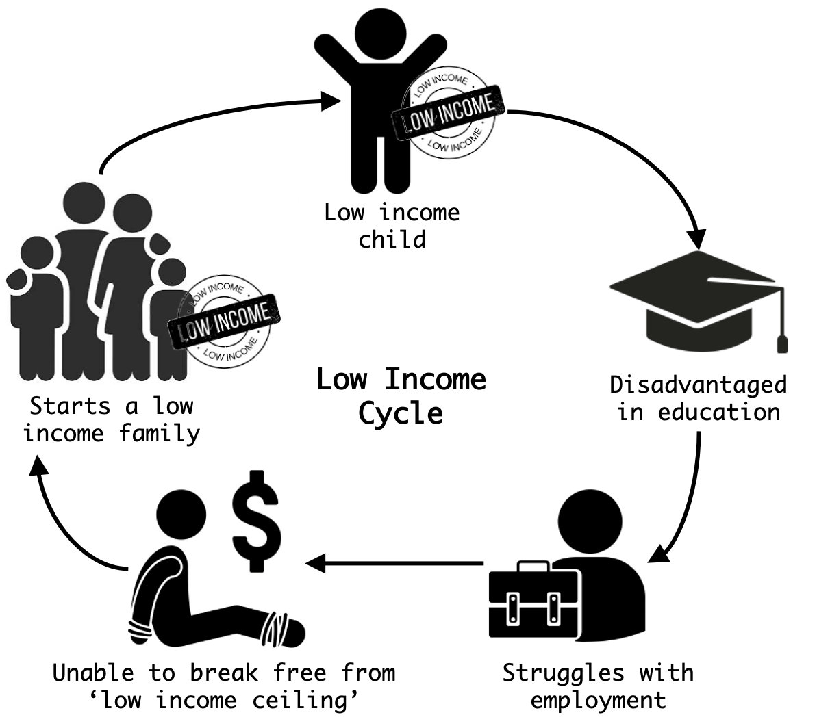
Notes:
Let’s begin… I’m sure many of you have seen this diagram before:
Child from a low income family - disadvantaged in his education due to lack of resources
This results in him struggling with employment and being unable to break the ‘low income ceiling’
Finally, he starts a low income family, and gives rise to the next generation of low income children
What if we broke the cycle early, say in the child’s education. As Horace Mann puts it in 1848 - education is the great equalizer!
Hi, my name is Zhe Wei. Together with my group mates Flash, Sean, Chee Tzen and Brandon, we are data scientists working with the board of education in the state of California.
All of us strongly believe that the SAT, which iis a standardized test that is used for college admissions in the U.S. is a fair evaluation on students’ readiness for college/career.
That SAT increases their chances of gaining admission to good schools and subsequent upward social mobility in the long-term which will narrow the income gap.
We are especially concerned with low SAT participation rates amongst students from poorer socio-economic counties in California.
This brings us to our problem statement -
We want to identify the relationship between County Income and SAT Participation Rate.
Should there be a Positive Correlation, we want to propose qualitative solutions to improve SAT participation rates of students from lower-income counties.
Here’s a brief summary of today’s presentation:
I have already covered the background and problem statement. The rest of my team will touch on the EDA, Visualisations, Scholarly findings and finally conclusions and recommendations
Over to you Sean!

Slide 3
Break the cycle here!
“Education, then, beyond all other devices of human origin, is the great equalizer of the conditions of men, the balance wheel of the social machinery.”
— Horace Mann, 1848.
Notes:
Break poverty cycle at the education part
The SAT, which is administered by the College board, is a standardized test that is used for college admissions in the U.S. As the board of directors on the Educational Testing Services under the College Board, we assert that participation in SAT test may likely translate to fair evaluations on students’ readiness for college/career, increase their chances of gaining admission to good schools and subsequent upward social mobility in the long-term. We are especially concerned with low SAT participation rates amongst students from poorer socio-economic counties in California, U.S, and would like to propose best practices to improve SAT participation amongst students from low socio-economic counties.

Slide 4


As a team of data scientists from the Board of Education of California, we want to...
Choice Colleges
SAT
Identify the relationship between County Income and SAT Participation Rate.
Should there be a Positive Correlation, we want to propose qualitative solutions to improve SAT participation rates of students from lower-income counties.
Better Job Opportunities
Narrow Income Gap

Slide 5
Executive Summary
Background Problem Statement
EDA (Procedures and methodologies)
Visualisation
Scholarly Findings
Conclusion and Recommendation

Slide 6




Procedures & Methodologies
Income?
Why Low SAT participation?
Culture?
Location?
Notes:
Across all states in the US, SAT participation rates continue to rise from 2017 to 2019. In this data, we actually noticed California - being the largest state - continues to show consistently low SAT participation rates as compared to other states. Our data shows California is not even in the top 15 states with the most SAT participation. This is even more surprising to note given that California, being ranked as the largest US state, comprise of 1.95 million students enrolled in public high schools in California, which is actually the highest figure in the United States. (https://www.statista.com/statistics/1036120/public-high-school-enrollment-state-us/).
There are many explanations for consistently low SAT participation rates in California, US. Could it be location? Income? Culture?
Multiple sources have pointed out that participation rates in SAT appear to be influenced heavily by factors, especially socioeconomic status or income levels. Income related factors such as upfront SAT fees or even future tuition fees for university would discourage young people from poorer backgrounds from going to university, thus their refusal to participate in SAT.
We turn to our problem statement - that we would like to explore the relationship between SAT participation rates amongst students and household income levels (one of the factors) counties in California, U.S, and would like to propose best practices to improve SAT participation amongst these students.
**Reference https://thermtide.com/10448/uncategorized/sat-battles-claim-of-socioeconomic-discrimination/
https://files.eric.ed.gov/fulltext/ED561029.pdf
https://ifs.org.uk/bns/bn133.pdf

Slide 7


Procedures & Methodologies (contd): Importing libraries
CSV files used:
2019 Participation rate and scores of counties for SATs in the various counties in California, US
2019 Household median income by county
Notes:
As part of our methodology, we imported various CSV files. Including
- `Import CSV files`:
- *Participation rates and scores in 2017, 2018 and 2019 SAT administration by US states* (sat_2017, sat_2018, sat 2019)
- *2019 Participation rate and scores of counties for SATs in the various counties in California, US* (sat_2019_ca)
- *2019 Household median income by county* (median household income by county)
- `Import libraries`: *scipy.stats, pandas, numpy, matplotlib.pyplot, seaborn as sns*

Slide 8


Procedures & Methodologies (contd): Cleaning Data
Checklist for Cleaning Data
Data Quality (validity, accuracy, completeness, consistency, uniformity)
Data drawn from U.S. Census and U.S. College Board
Constraints considered (eg data type, mandatory, unique)
Cross field validation (e.g. Total score of SAT cannot be less than Math score)
The workflow
Inspection (data profiling, visualizations. etc)
Detect unexpected, incorrect, and inconsistent data.
Check for missing values (NaN values) and management of it.
Cleaning
Drop unwanted/irrelevant/duplicate columns
Type conversion, Fix syntax errors (e.g. white spaces), typos
Column names changed to lowercase
Replace weird/undesirable values
Ensure column names are unique and informative
Made values more readable by removing unnecessary words
Standardized!
Notes:
Step 2 - Clean the data
Data-type constraints: values in a particular column must be of a particular datatype, e.g., boolean, numeric, date, etc.
Data profiling
A summary statistics about the data, called data profiling, is really helpful to give a general idea about the quality of the data.
For example, check whether a particular column conforms to particular standards or pattern. Is the data column recorded as a string or number?.
How many values are missing?. How many unique values in a column, and their distribution?. Is this data set is linked to or have a relationship with another?.
Visualizations
By analyzing and visualizing the data using statistical methods such as mean, standard deviation, range, or quantiles, one can find values that are unexpected and thus erroneous.

Slide 9

Procedures & Methodologies (contd): Merging Data
Merged 2 files:
2019 Participation rate and scores of counties for SATs in the various counties in California, US
2019 Household median income by county
New merged dataframe (e.g. sat2019calinew) saved as CSV in code folder
Dataframes merged so statistical analysis can be done
Notes:
*ignore this point*
Merged all 3 files (e.g. sat_2017, sat_2018, sat_2019) to create a new file (e.g. sat_2017_18_19)
New merged dataframe (e.g. sat_2017_18_19) saved as CSV in code folder

Slide 10


Let’s explore!!
Procedures & Methodologies (contd): Data exploration using the new dataframes
Inspection part 2 (data profiling, visualizations, etc)
Data profiling again:
Measures of central tendency: e.g. mean, median mode.
Measures of variability: e.g. Standard deviation, minimum and maximum values.
E.g. df.describe() to find mean value of participation rates across counties in grade 11 and 12 respectively
Shape of a dataset’s distribution
Sorted values functions often used E.g. to find the top 10 counties with highest SAT participation rates in grade 11 and 12, and bottom 10 counties with lowest SAT participation rates in grade 11 and 12
Visualization
Generated Plot box, heatmap and Bar charts to discover data trends
Notes:
Data profiling
A summary statistics about the data, called data profiling, is really helpful to give a general idea about the quality of the data.
For example, check whether a particular column conforms to particular standards or pattern. Is the data column recorded as a string or number?.
How many values are missing?. How many unique values in a column, and their distribution?. Is this data set is linked to or have a relationship with another?.

Slide 11
Visualization (Overview)
SAT Participation Rate vs Low Median Household Income
Bar Charts
Heatmap
Linear Regression Model

Slide 12
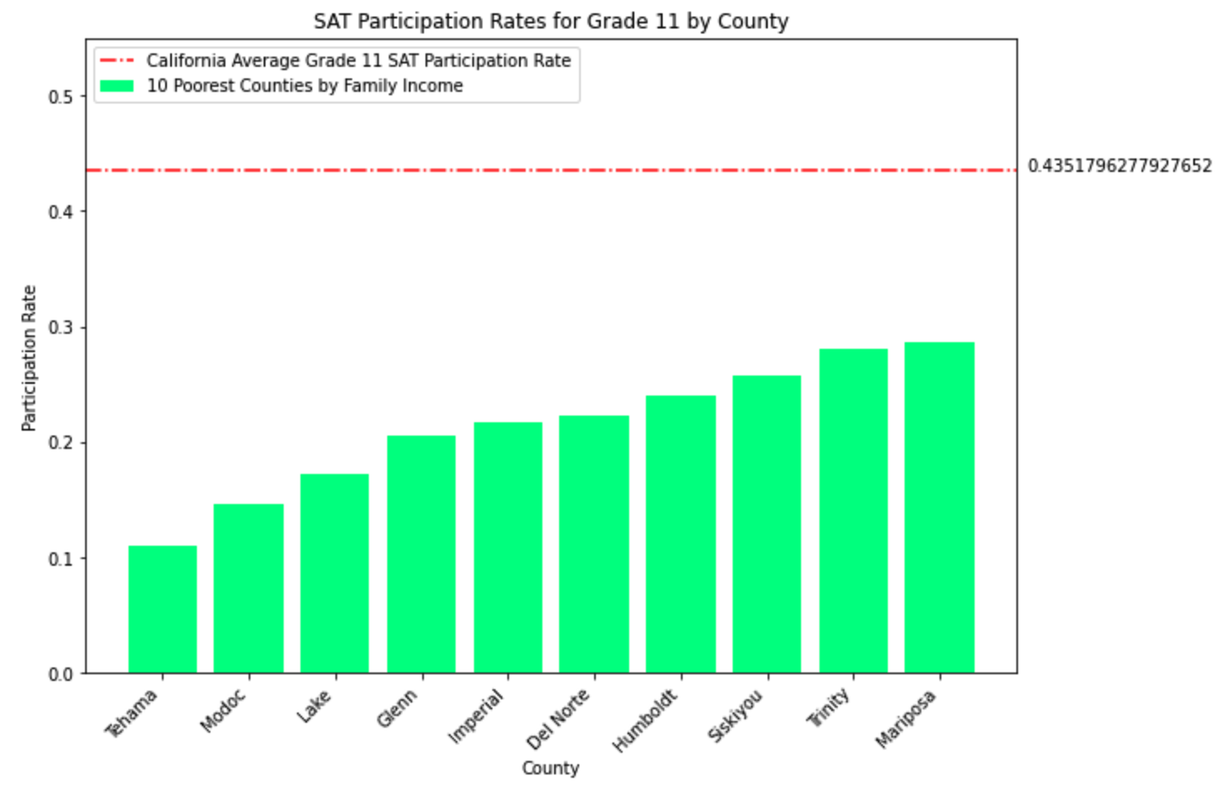
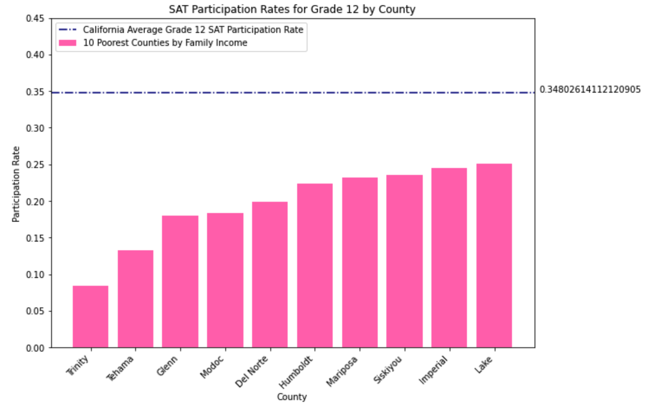
SAT Participation rate vs Low income
Bar charts shows Median Household income counties vs SAT Participation Rate at different Grades
10 low median household income counties as shown
Low Median Household Income = Low Participation Rate
SAT Participation Rate for Average Grade 12 & 11 in California

Slide 13
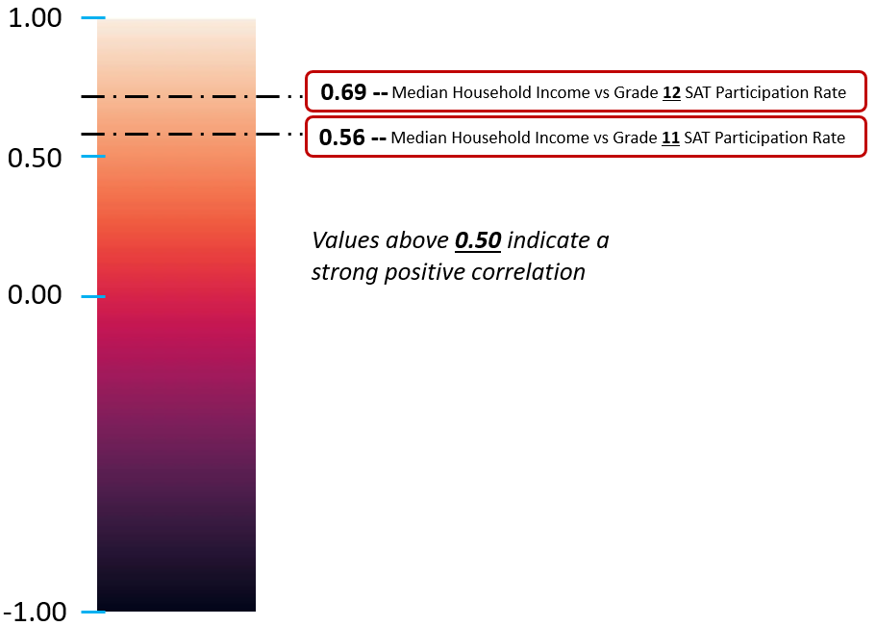
HEATMAP- Participation rate vs Low income
Figure shows, Heatmap of Median Household income (USD) vs Participation Rate
SAT Grade 12 = 0.69
SAT Grade 11 = 0.56
Both heatmap are above 0.5

Slide 14

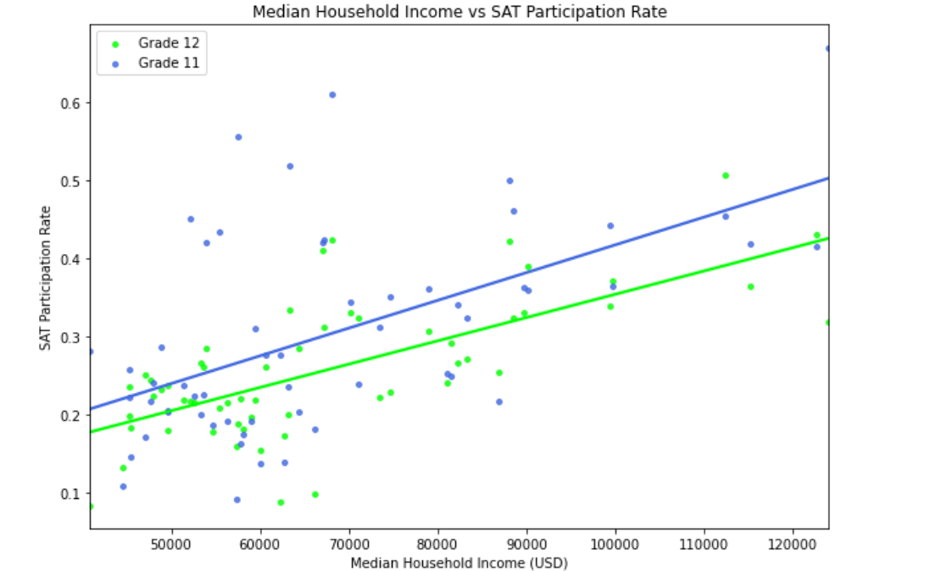
linear regression model
Fig shows SAT participation rate being affected by low median household income(USD)
The lower Median Household income (USD), the lower participation rate for SAT
SAT Participation Rate = 0.2 , Median Household Income = 25000
There is a strong positive correlation.

Slide 15
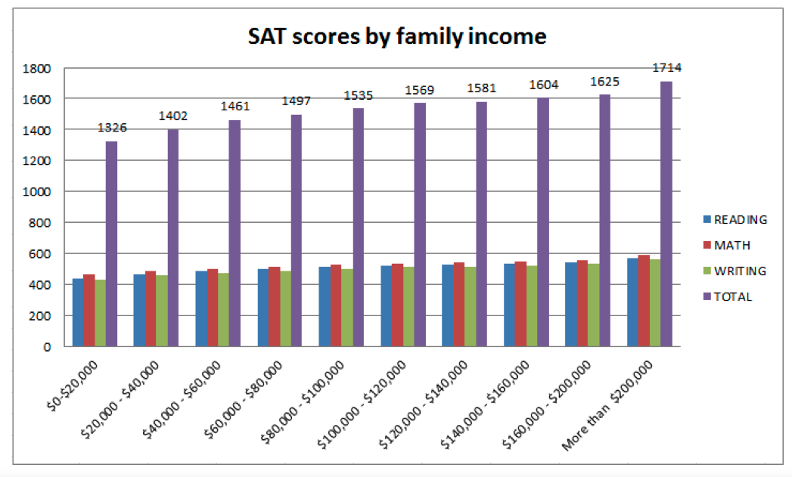
Parental income and socioeconomic status are correlated to academic achievement. (Dixon-Román, 2007; Rothstein, 2004)
Research shows that parental income has a substantial effect on academic achievement and accounts for a meaningful proportion of the score gap between high income families and the low income families.
Notes:
The graph shows that students from families earning more than $200,000 a year average a combined score of 1,714, while students from families earning under $20,000 a year average a combined score of 1,326.

Slide 16
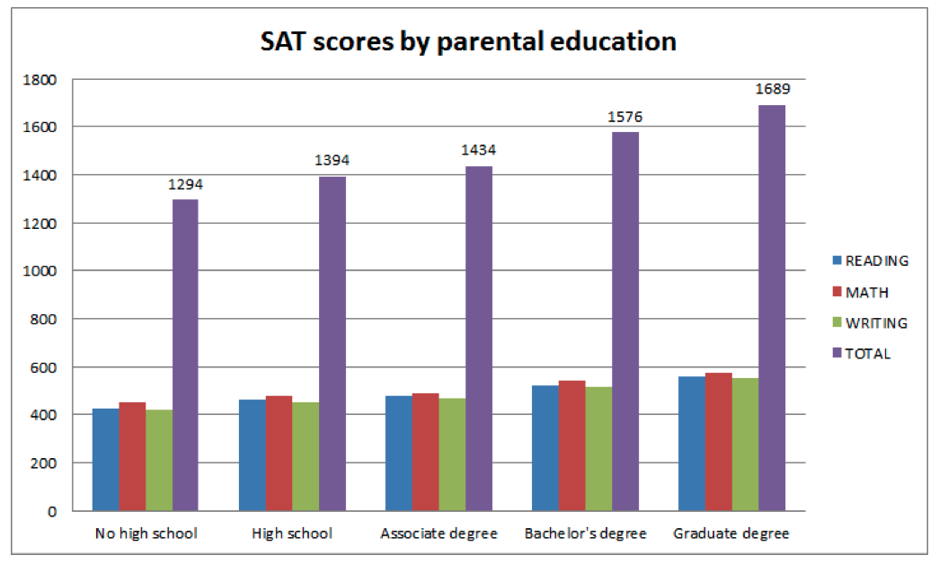
Parental education is correlated to academic achievement. (Mattern, Shaw, & Williams, 2008; Zwick, Brown, &
Sklar, 2004)
Research shows that parental education has a significant effect on academic achievement and accounts for a meaningful proportion of the score gap between high income families and the low income families.
Notes:
The graph shows that students from educated families do better than the less educated family. For example, a student with a parent who has a graduate degree, on average scores 300 points higher on their SATs compared to a student with a parent who has only a high school degree. This also reflects in the income graph as a parent with graduate degree will definitely earn more than a parent with high school certificate. Mattern KD, Shaw EJ, & Williams FE (2008). Examining the relationship between SAT, high school measures of academic performance and socioeconomic status: Turning our analysis to unit of measure. College Board Publications.
Zwick R, Brown T, & Sklar JC (2004). California and the SAT: A reanalysis of University of California admissions data Center for Studies in Higher Education, UC Berkeley, Research and Occasional Papers Series; Retrieved January 11, 2013 from http://cshe.berkeley.edu/publications/rops.htm.

Slide 17
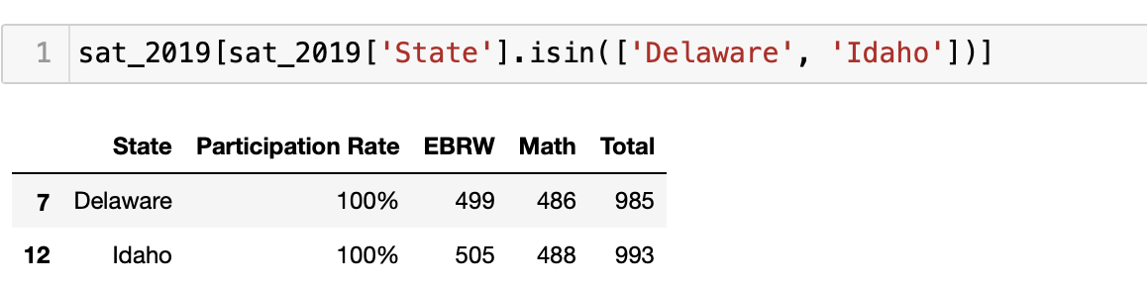
Strategies that work to increase SAT participation
Offering SAT at no cost
Free access to the College Board’s official SAT online course
Conducting SAT exam during regular school hours with transportation provided.
Engagement with the school counselor
Notes:
1. Delaware and Idaho have implemented SAT at no cost to students since 2011 and 2012 respectively. The program is offered to all 11th grade students who enrolled in the public schools. The students are able to complete the exam during a regular school day instead of the non school day.
2. In order to prepare students to complete the SAT successfully, the Delaware Department of Education provides all 11th grade students enrolled in public schools with free access to the College Board’s Official SAT Online Course. Individual districts have also implemented their own SAT preparation programs; for instance, Red Clay Consolidated School District offers a seven‐week SAT prep class free of charge.
3. This can reduce potential Saturday testing barriers (e.g., part-time jobs, family responsibilities). A research found that earnings supplements do matter for children’s academic achievement in poor families.
4. The College Board reports obtaining a fee waiver does not guarantee test participation. The two most common reasons for test day absenteeism among fee‐waiver recipients were 1) feeling unprepared and 2) not having transportation. Fee‐waiver recipients indicated that the school counselor was the most important influence in deciding whether to register, and they would have been more likely to be present on test day with more encouragement, increased accessibility to test centers, and more preparation. Hence, it is important for students to be confident by having more SAT prep class and engagement with the school counselor.

Slide 18

Conclusion
SAT increases students’ chance of admission to good school and narrow income gap in the long run. Our goal is to improve SAT participation rate.
Household income is strongly correlated with SAT participation rate.
Recommendations to improve SAT participation rate:
Offering SAT at no cost
Conducting SAT exam during regular school hours with transportation provided.
Engagement with the school counselor
Free access to the College Board’s official SAT online course
Notes:
I will do a quick summary on what we have presented today. Basically,we are firm believers that Education is the key to break poverty cycle, and since SAT is widely recognised, SAT can increase students’ chance to get into a good university and narrow income gap in the long run. Hence our goal is to improve SAT participation rate.
Our research went beyond the data given to us, and we have included other data such as household median income into our analysis. To be able to analyse various sources of data, we spent considerable time to add, remove, convert, standardize our data for further analysis.
Once we are able to merge the all the relevant data, we noted that household income is strongly correlated to SAT participation rate as evidenced by correlation of more than 0.5 in the heatmap.
Hence, our team suggests the following strategies to improve SAT participation rate:
Offering SAT at no cost. But we know students still may not participate even if it is free, because of lack of confidence and lack of transport.
Hence it should be complemented by conducting SAT exam during regular school hours with transport to test centre.
There should be sufficient support from school counsellor and teachers.
Last but not least, free online access to SAT material should also be provided to students.
That’ all for our presentation. Thank you.

Slide 19
Reference:
Camara, W. J. & Schmidt, A. E. (1999). Group differences in standardized testing and social stratification. College Board Report (99)5. New York, NY: College Board.
Zwick, R. (2004). Is the SAT a “Wealth Test”? The link between educational achievement and socioeconomic status (pp. 203–216). In R. Zwick, (Ed.). Rethinking the SAT in university admissions. New York, NY: Routledge Falmer.
“Free SAT registration now open for public school juniors.” Delaware PTA, February 10, 2014. http://delawarepta.org/free‐sat‐registration‐now‐open‐for‐public‐school‐juniors/
Adams, C. “Delaware Gives All Juniors SAT During School Day.” Education Week, January 25, 2011. http://blogs.edweek.org/edweek/college_bound/2011/01/all_high_school_juniors_in_delaware_take_sat_starting_in_april.html
“SAT.” Idaho State Department of Education. http://www.sde.idaho.gov/site/assessment/SATstudentParent.htm
Duncan, G. J., Huston, A. C., & Weisner, T. S. (2007). Higher ground: New hope for the working poor and their children. New York: Russell Sage Foundation.
.

Slide 20
Reference:
Rothstein, R. (2004). Class and schools: Using social, economic, and educational reform to close the Black-White achievement gap. Washington, DC: Economic Policy Institute.
Sirin, S. R. (2005). Socioeconomic status and academic achievement: A meta-analytic review of research. Review of Educational Research, 75(3), 417–453.
Mattern KD, Shaw EJ, & Williams FE (2008). Examining the relationship between SAT, high school measures of academic performance and socioeconomic status: Turning our analysis to unit of measure. College Board Publications.
Zwick R, Brown T, & Sklar JC (2004). California and the SAT: A reanalysis of University of California admissions data Center for Studies in Higher Education, UC Berkeley, Research and Occasional Papers Series; Retrieved January 11, 2013 from http://cshe.berkeley.edu/publications/rops.htm.

